Slide 1
Kafka

Slide 2
Agenda
Data Systems Evolution
Messaging systems
Kafka - What & Why ?
Kafka Eco System
Components
Topics & Messages
Internals
Use Cases @ Optum
Lab exercises

Slide 3
Data Systems Evolution
Data sources…
File systems, Relations databases, Warehouses, Big data stores, Messaging systems, and streams
Messaging Tools
RabbitMQ
IBM MQ
Streaming Technologies
Kafka
Kinesis
Real-time and Lambda
Notes:
Notes:
Useful links

Slide 4
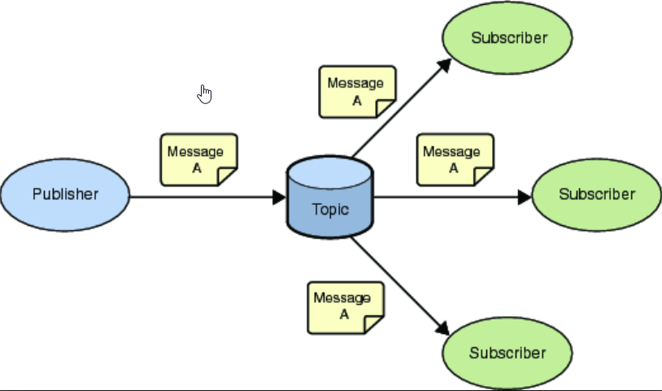
Messaging systems
What-if: If you have to publish the same message to multiple consumers
Scalability and Message replay
Destructive reads
Notes:
Notes:
Useful links

Slide 5
Kafka - What & Why ?
Open-source, Distributed publish-subscribe messaging system
Application areas
Messaging system
Activity tracking
Logging
Stream processing
Sample Use Cases
Netflix uses Kafka to send real-time recommendations to you, while you are watching TV shows
Uber uses Kafka to compute forecast demand and surge pricing in real-time,. It gathers user, taxi, and trip data.
LinkedIn uses Kafka to recommend user connections, to prevent spam
Notes:
Notes:
Useful links

Slide 6
Kafka - Streaming Eco System
Kafka Producer: Produce data push that to Kafka
Kafka Consumer: Consume data from Kafka in real-time and perform real-time action
Kafka Connect Source: Produce data from a data store to Kafka by performing ETL
Kafka Connect Sink: Consume data from Kafka and store it in a data store
Kafka Streams: Read from Kafka, do the stream processing and produce back into Kafka.
KSQL: Write your code SQL-like, to read from Kafka, do the stream processing

Slide 7
Kafka - Components
Brokers and Topics:
Basically a server in a Kafka cluster.
Each broker will contain certain partitions of a topic
Brokers Discovery:
Each Broker knows about all the other broker, topics, and partitions
Once a program connected to q broker, it gets the details about the topic and connect to the appropriate broker which hosts the partition
+ Exactly Once
*

Slide 8
Kafka Topics and Messages
Topic:
A particular stream of data.
Every record is called a message.
A topic will have a name
Data is kept for a limited duration
Partitions:
Topics are split in partitions.
Partitions are ordered
Data once written to the partition, it CANNOT be changed. It's immutable.
Offset:
Unique id given to a message with in a partition
First message will have an offset of "0"
Offset will NEVER go back to zero, even after the earlier messages are deleted.
Message
To identify a message - use the partition id & offset together
Message in a particular partition is chronologically ordered.
Messages across partitions in a topic are NOT chronologically ordered

Slide 9
Kafka – Internals
Topic Replication:
Distributed world needs replication.
At any point in time, there will be one broker for a partition which will serve as a leader.
Leader sends and receives data. Other brokers just stay in sync.
Producer - Data Acknowledgement
Producer can choose to receive acknowledgment from the Broker
Producer won't wait for acknowledgment
Producer will wait for acknowledgment
Producer will wait for acknowledgment for leader and replicas
Message keys
Data is sent in round robin across partitions
Data for a particular key is always sent to a particular partition. Key hashing.
Consumers and Consumer Groups:
Consumers can read from multiple partitions for a single topic in parallel.
Consumer read data in groups, called consumer groups
Two consumers of the same group will read from mutually exclusive partitions
Consumer Offsets/ Acknowledgement
Stored to a Kafka topic "__consumer_offsets”
Consumers can continue from where they left
Delivery Semantics
Consumer choose when to commit offsets
Commit once received
Commit once received and processed

Slide 10
Kafka – Implementation APIs
Kafka Producer-Consumer API
Kafka Streams API
Kafka Spring Cloud API

Slide 11
Use Cases @ Optum
Provider Data Platform:
P360
EPIM
Data Fabric/DF3 Streams
Consumer360
OCM 2.0

Slide 12
Thank you P360 Team

